Slide 1
MER311: Advanced Strength of Materials
LECTURE OUTLINE
Strain – Displacement Relations
Thermal Expansion
Moisture Expansion

Slide 2
Strain-Displacement Relationships

Slide 3
Normal Strain - Displacements

Slide 4
Shear Strain - Displacements

Slide 5
Curvature - Displacements

Slide 6
Strain-Displacement Relations
Cylindrical System

Slide 7
Example
The following displacement field is applied to a certain body where k=10^{-4.}
u=k(2x+y²), v=k(x² -3y²), w=0
(a) Show the distorted configuration of a two-dimensional element with sides dx and dy and its lower left corner (point A) initially at the point (2,1,0), i.e., determine the new length and angular position of each side.

Slide 8
Anisotropic Materials
ISOTROPIC - material properties are the same in all directions
ANISOTROPIC - material properties change with direction
HOMOGENEOUS - material of uniform composition throughout and whose properties are constant at every point
HETEROGENEOUS - material uniformity within a body consisting of dissimilar constituents separately identifiable

Slide 9
Stress-Strain Relations
Stiffness
Compliance

Slide 10
Symmetry of the
Stiffness Matrix
Elastic Potential/Strain Energy Density
  Incremental work per unit volune
  dW=σ_{i}dε_{i}
Using the Stress-Strain Relations
  dW=C_{ij}ε_{j}dε_{j}
Work per Unit Volume
  W=1/2 C_{ij}ε_{i}ε_{j}
dW/dε_{i}=C_{ij}ε_{j} or dW²/dε_{i} dε_{j} =C_{ij} thus C_{ij}= C_{ji}

Slide 11
Stiffness and Compliance down from 36 to 21 Constants
Stiffness
Compliance

Slide 12
One Plane of Elastic Symmetry
Monoclinic
13 Independent Constants

Slide 13
Three Planes of Elastic Symmetry
Orthotropic Body
9 Independent Constants

Slide 14
Relationship Between S and C

Slide 15
One Plane in which the Mechanical Properties are Equal
Transversely Isotropic
6 Independent Constants

Slide 16
Material Properties Equal in all Directions
Isotropic
2 Independent Constants

Slide 17
Matrix Form of Stress-Strain Relations

Slide 18
Example 1
Given the following state of stress, determine the state of strain.

Slide 19
Example 2
Given the following state of strain, determine the state of stress.

Slide 20
Free Thermal Strains
Material Expands and Contracts when Heated and Cooled
Rate of Expansion Different in the 3 Principal Material Directions
  Graphite fibers contract along their length when heated
  Polymers, aluminum, boron, ceramics and most other matrix materials expand when heated

Slide 21
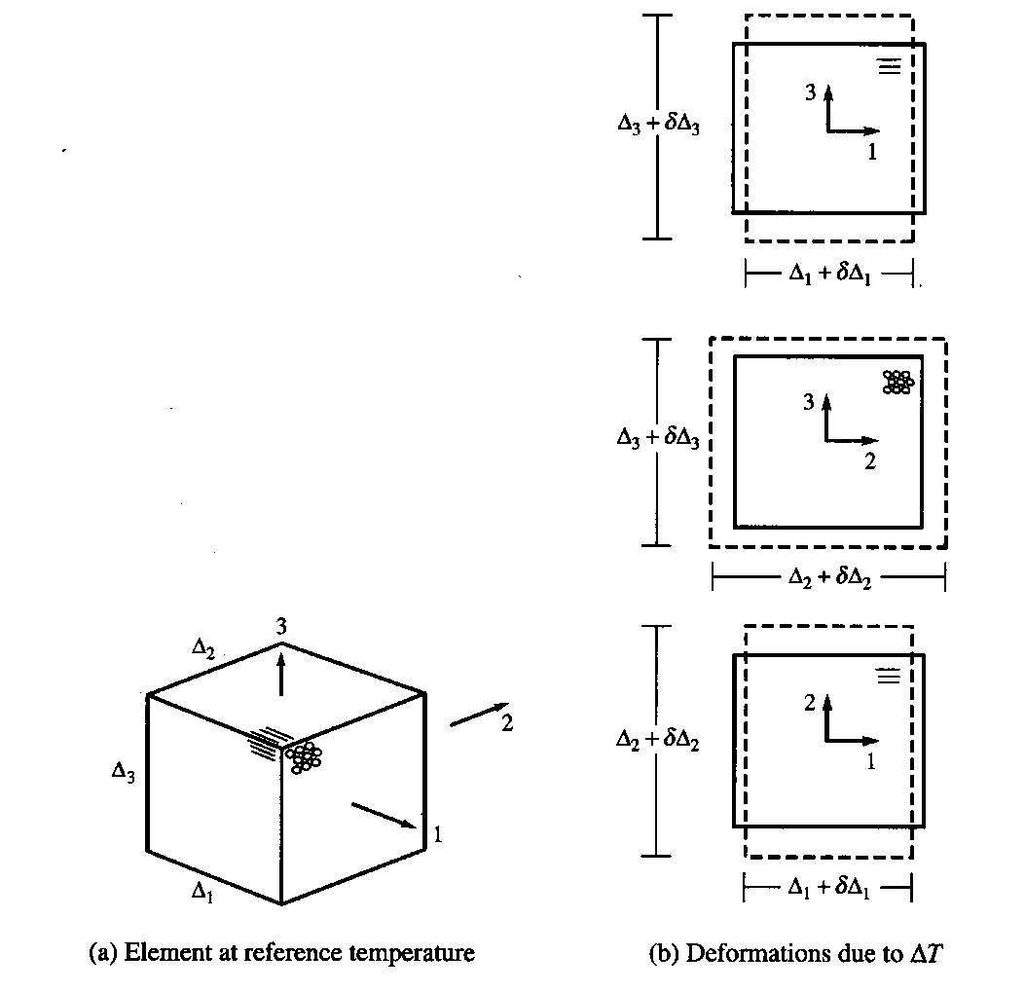
Free Thermal Strain
Directly Related to Change in Length

Slide 22
Thermal Expansion Coefficient
Thermal Expansion is Linear with Temp

Slide 23
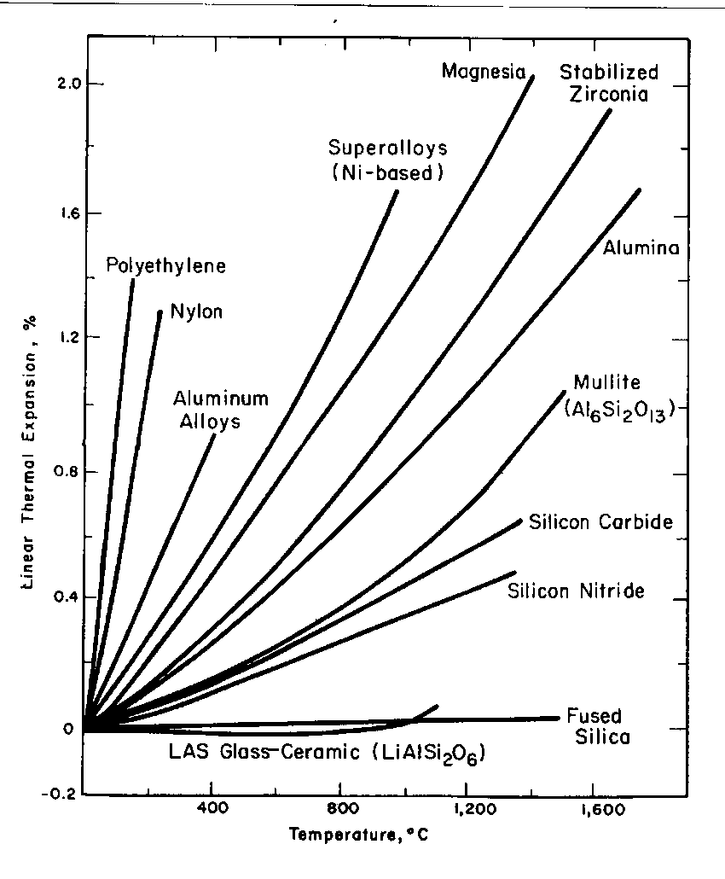
Linear CTE for Various Engineering Materials

Slide 24
Notes on Linear Thermal Expansion Coefficients
α₁, α₂, and α₃, are referred to as the LINEAR coefficients of thermal expansion
If expansion effects are not linearly proportional to temperature, α’s have no meaning
Free thermal strains do not involve any shearing deformations
For an element of material isolated in space, the thermal strains do not result in stresses

Slide 25
σ-ε Relations Including Thermal Strains (Compliance)

Slide 26
σ-ε Relations Including Linear Thermal Strains (Compliance)

Slide 27
σ-ε Relations Including Linear Thermal Strains (Stiffness)

Slide 28
Hygroscopic Strains
Polymers exposed to liquids will
  absorb moisture
  expand, typically linearly with %Moisture
Free Moisture Strains

Slide 29
Thermal/Mechanical Properties-Compliance

Slide 30
Thermal/Mechanical Properties-Stiffness

